Slide 1
Headline finding
Athletic Spending
& Academic Outcomes
−1.12
Within-division slope: a 1pp increase in athletic spending share is associated with roughly a 1pp drop in 6-year graduation rate.
A cross-sectional analysis of NCAA institutions
Valentino Salerni
April 30, 2026
445 NCAA D-I & D-II public institutions | 2023 academic year

Slide 2
Research Question
Why this question?
Does the share of institutional spending allocated to athletics correlate with academic outcomes (6-year graduation rates), and does this relationship vary across NCAA divisions?
Why it matters
Public discourse questions whether large athletic budgets detract from academic mission or support it through enrollment, branding, and donor relationships.
Recent NIL reforms and conference realignment have intensified the question of how athletic dollars relate to institutional outcomes.
SCOPE
Cross-sectional, descriptive. Sample restricted to public NCAA D-I and D-II institutions for the 2023 academic year. Findings are correlational, not causal.
Athletic Spending & Graduation Outcomes | 2 / 13

Slide 3
Data Collection & Understanding
Three federal data sources, merged on UNITID
1
2
3
EADA
IPEDS Finance
IPEDS Graduation Rates
Equity in Athletics Disclosure Act
F1A — public institutions, GASB
GR2023 — 2017 cohort, 6-year
Source: Office of Postsecondary Education
Source: NCES
Source: NCES
ROLE
ROLE
ROLE
Athletic spending (numerator)
Total expenses (denominator)
Outcome variable
KEY VARIABLE(S)
KEY VARIABLE(S)
KEY VARIABLE(S)
Grand Total Expenses
F1C191
GRTYPE 8 & 9 (cohort, completers)
1,319 schools
1,916 schools
51,391 records
LIMITATION: F1A covers only public institutions (GASB). Private nonprofits report on F2 (FASB) — different accounting standards make harmonization noisy. Restricting to F1A excludes most D-III schools and ~45% of EADA filers.
Athletic Spending & Graduation Outcomes | 3 / 13

Slide 4
Hypotheses
Two questions, two pairs
PRIMARY HYPOTHESIS — spending and outcomes
H₀: Athletic spending share has no linear relationship with graduation rate (β = 0).
H₁: Athletic spending share is linearly associated with graduation rate (β ≠ 0).
SECONDARY HYPOTHESIS — uniformity across divisions
H₀: The spending–graduation relationship is identical across NCAA divisions.
H₁: The slope differs across divisions (tested via interaction F-test).
Significance level: α = 0.05 throughout
Athletic Spending & Graduation Outcomes | 4 / 13

Slide 5
Data Cleaning & Preparation
From 1,319 raw rows to 445 analytical schools
Sample construction
Key cleaning steps
EADA athletics universe (raw)
1,319
Pivot GR file long → wide
Filtered GRTYPE = 8 (cohort) and 9 (completers); reshaped one row per school.
Computed two ratios
spendRate = sportsExpenses / totalExp, gradRate = completers / cohort.
Collapsed classifications
FBS / FCS / D-I no football / D-II / D-III; combined with/without-football D-II splits.
Outliers retained, flagged
A few D-II schools spend > 15% of budget on athletics. Kept; substantively meaningful.
Inner join with IPEDS Finance (F1A, public-only)
≈ 700
Inner join with IPEDS Graduation Rates
494
Filter to NCAA divisions only
445
Athletic Spending & Graduation Outcomes | 5 / 13

Slide 6
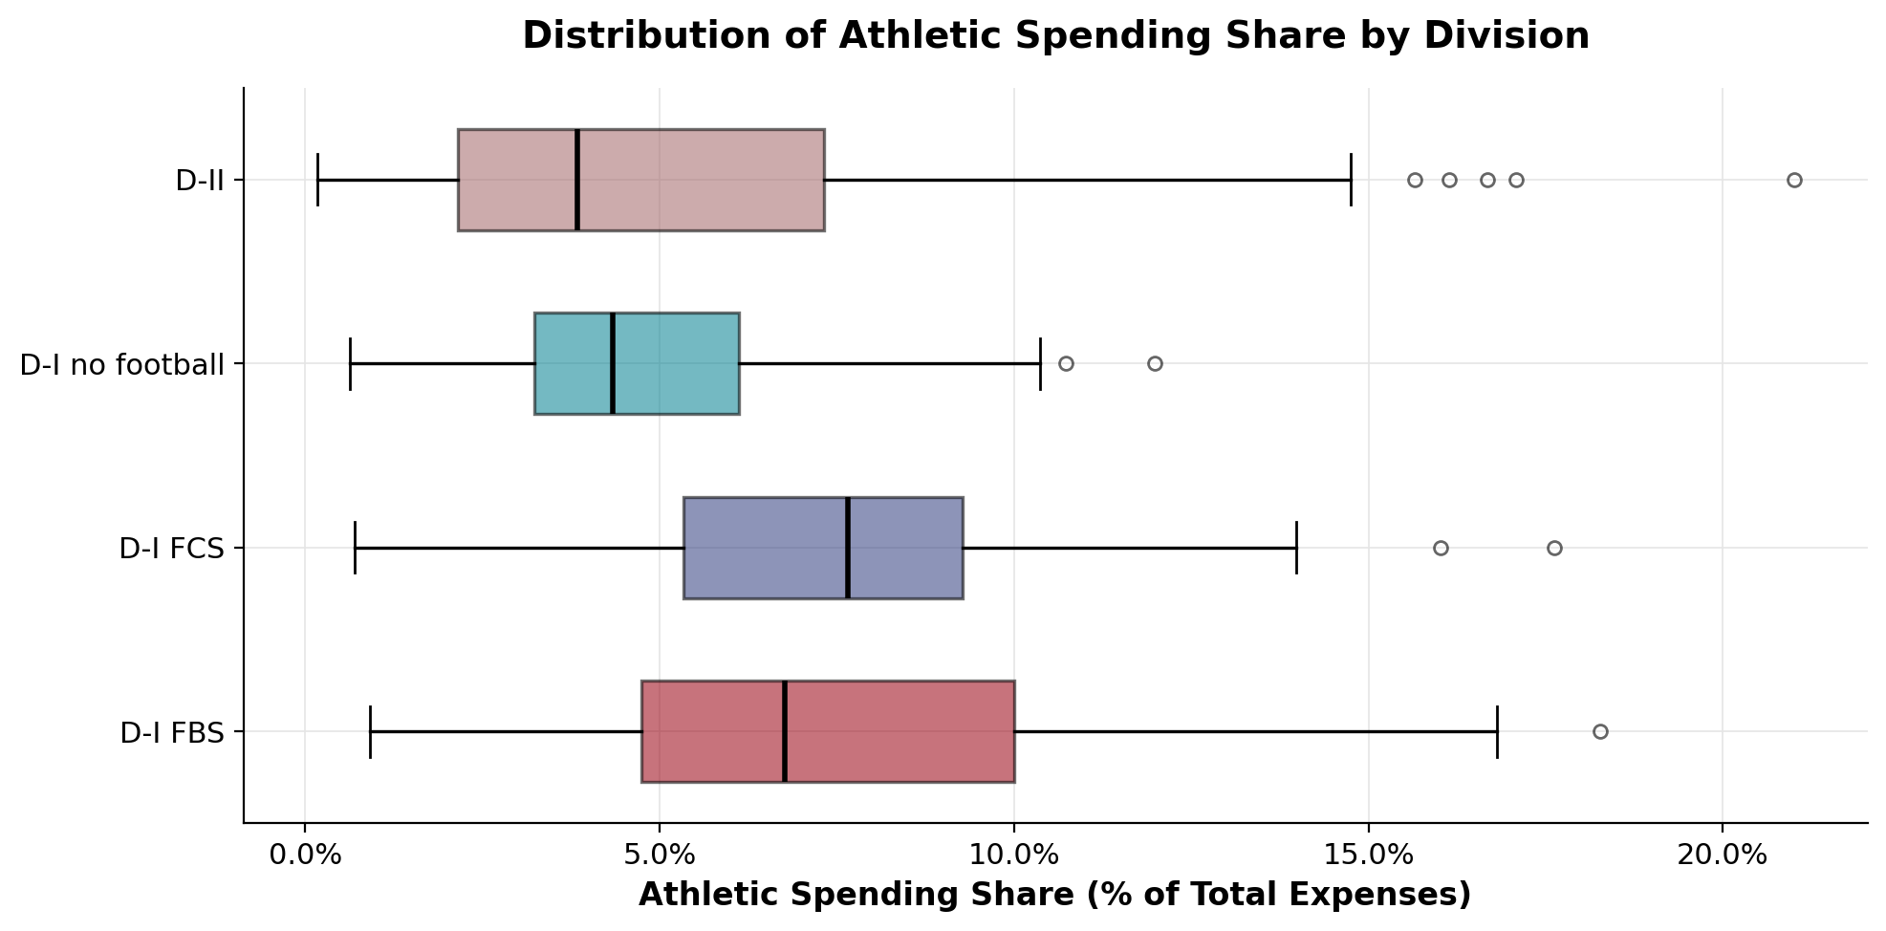
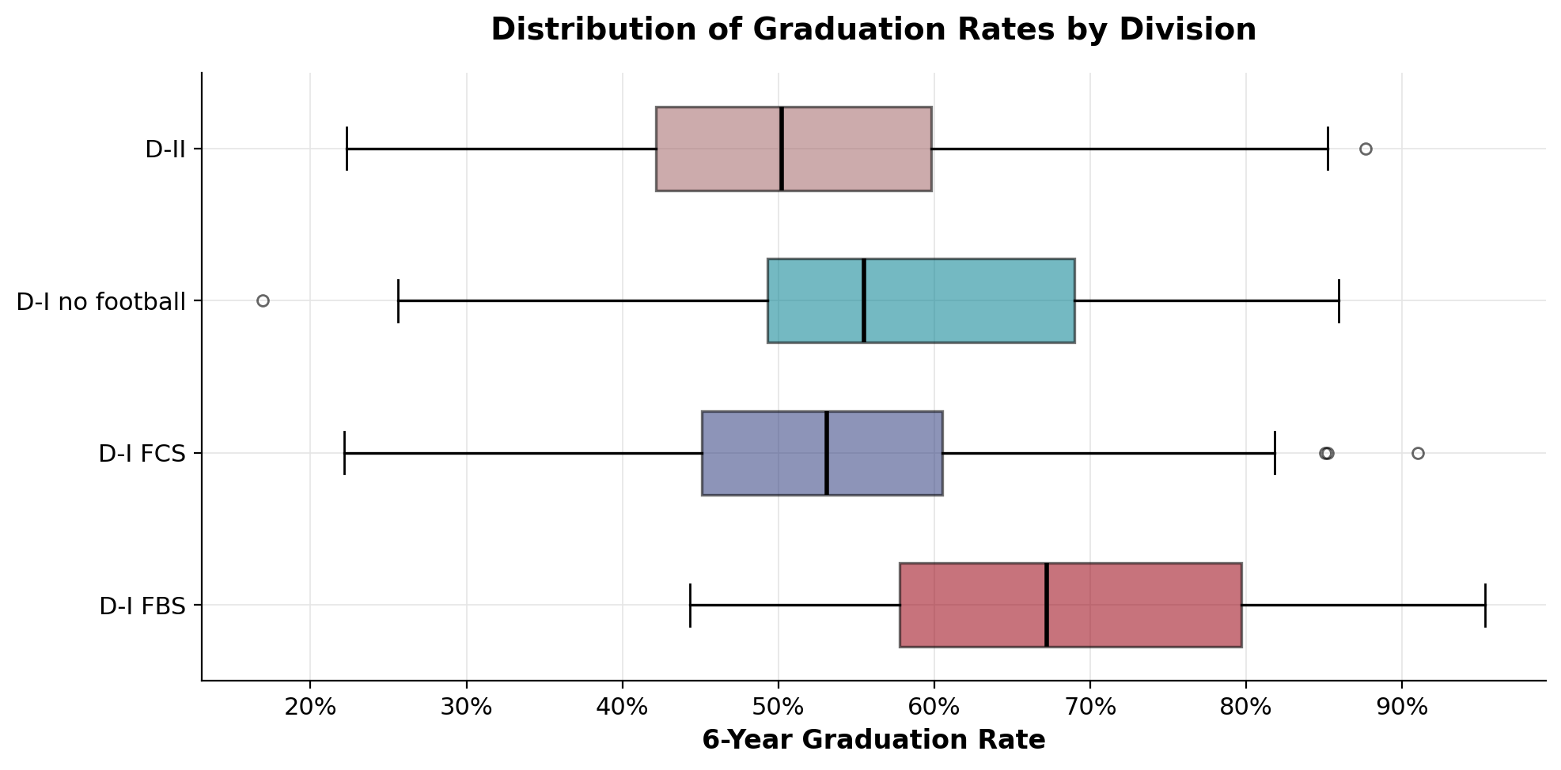
Exploratory Data Analysis
Divisions differ on both axes
WHAT THESE PLOTS SAY
Spending varies
Grad rates vary more
Outliers are real
FBS and FCS schools spend a higher share of budget on athletics (median ≈ 7%) than D-I no-football and D-II (median ≈ 4–5%).
FBS schools graduate ~67% within 6 years, vs. ~50–55% for FCS and D-II — a gap of 12–17 percentage points.
Some D-II schools spend > 15% of total budget on athletics. Kept in sample; flagged in cleaning.
Athletic Spending & Graduation Outcomes | 6 / 13

Slide 7
Descriptive Statistics
By NCAA division
Division | n | Mean spend share | Median spend share | Mean grad rate | Median grad rate | Within-div correlation
D-I FBS | 108 | 7.6% | 6.7% | 67.7% | 67.6% | −0.32
D-I FCS | 75 | 7.7% | 7.7% | 53.1% | 53.4% | −0.22
D-I no football | 46 | 5.0% | 4.4% | 56.4% | 55.5% | −0.47
D-II | 216 | 5.1% | 3.9% | 50.4% | 50.4% | −0.32
READING THE TABLE
All four within-division correlations are negative — schools that spend a higher share of budget on athletics tend to graduate fewer students. The correlation is strongest for D-I no football (−0.47) and weakest for D-I FCS (−0.22). Sample sizes are sufficient (n = 46 to 216) for inference within each group.
Athletic Spending & Graduation Outcomes | 7 / 13

Slide 8
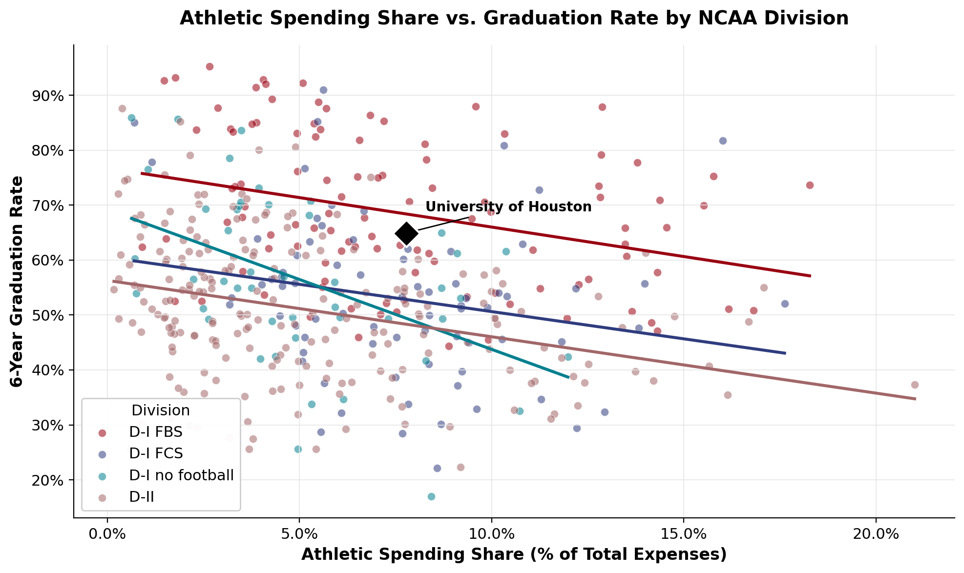
Headline Visualization
Spending share vs. graduation rate, by division
WHAT TO LOOK AT
Four downward slopes
All four divisions show a negative within-group relationship.
FBS sits highest
Even at higher spending share, FBS schools graduate more students than peers in other divisions.
UH sits near the FBS line
8% spending share, 65% grad rate — close to predicted FBS conditional mean.
Athletic Spending & Graduation Outcomes | 8 / 13

Slide 9
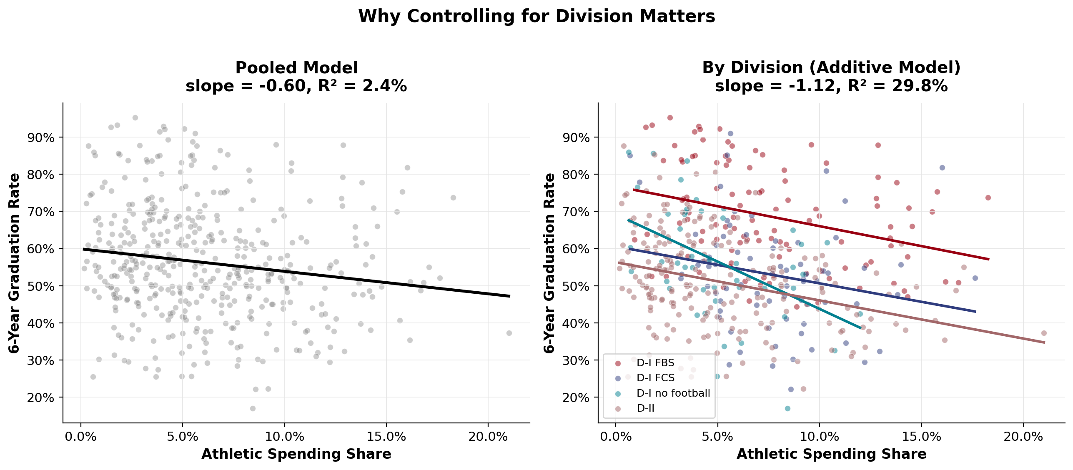
Modeling — Step 1: Pooled vs. Additive
Controlling for division reveals — not masks — the relationship
Naive pooled slope: −0.60 (R² = 2.4%)
Within-division slope: −1.12 (R² = 29.8%)
Athletic Spending & Graduation Outcomes | 9 / 13

Slide 10
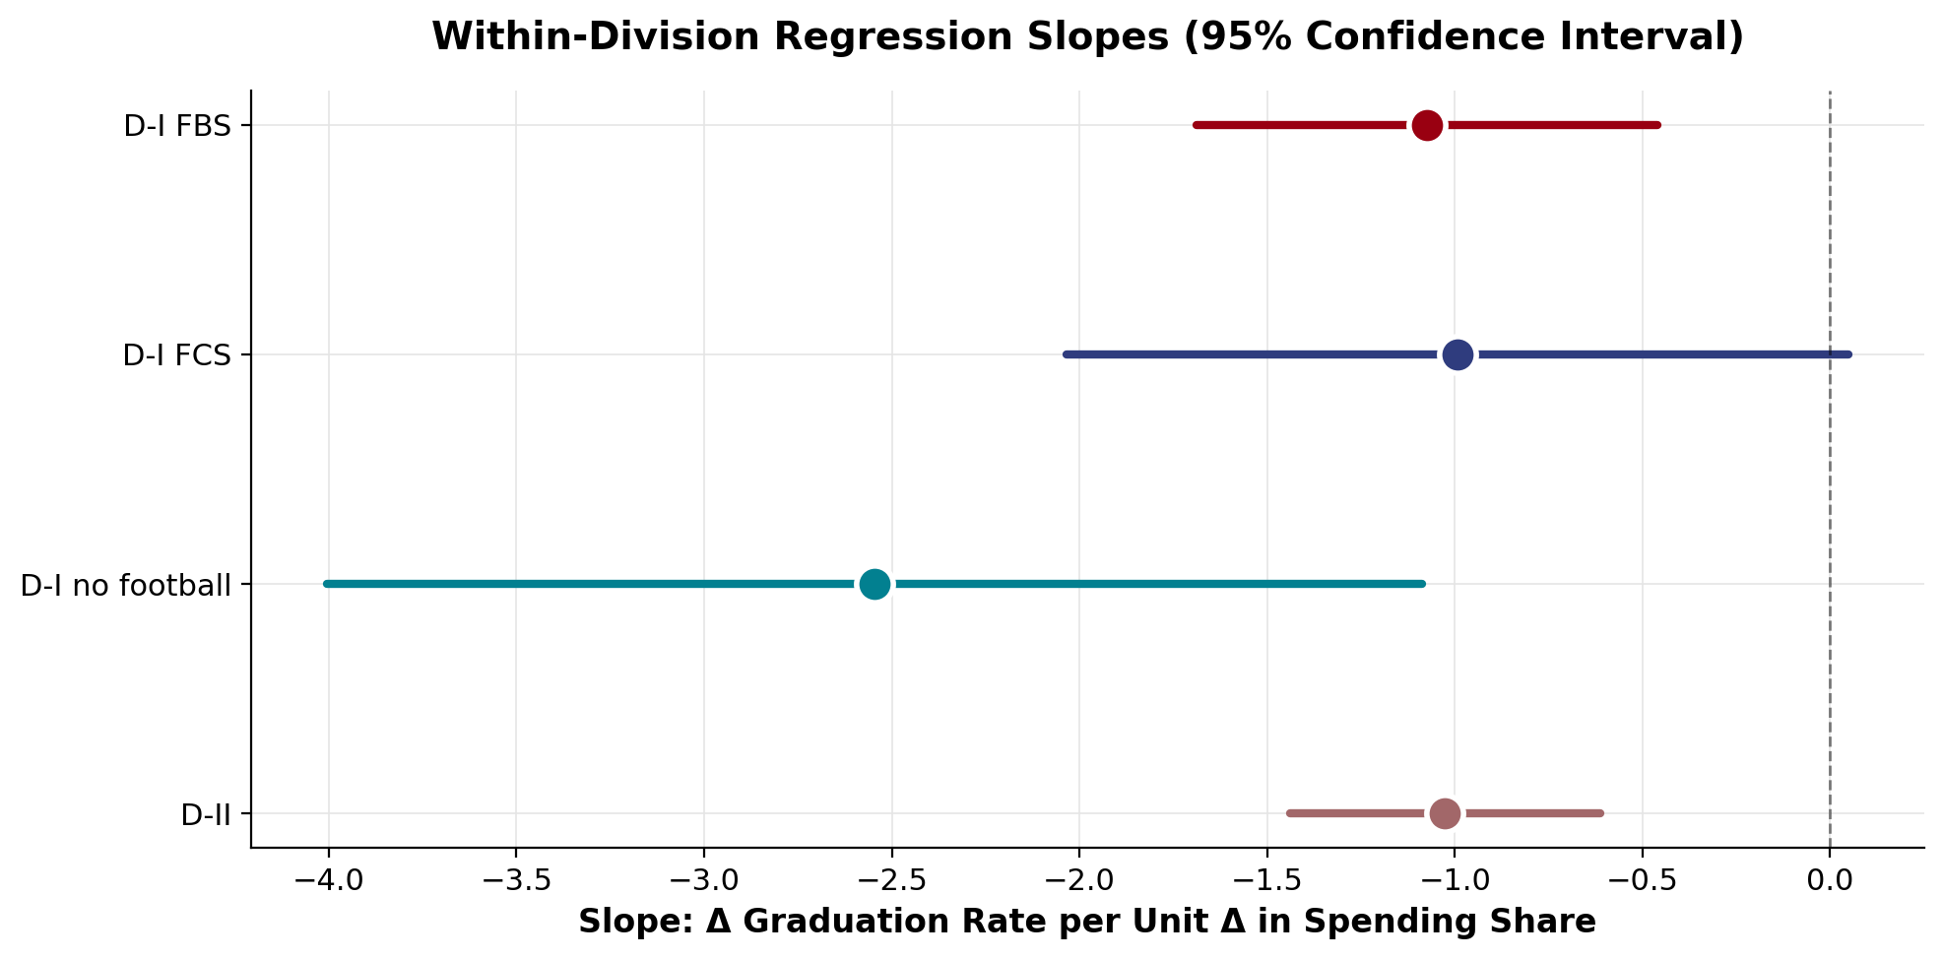
Modeling — Step 2: Are slopes the same across divisions?
Same slope, different intercepts
F-TEST
Additive vs.
Interaction Model
F = 1.56
p = 0.199
Fail to reject H₀.
Slopes do not differ significantly across divisions.
TAKEAWAY: The negative spending–graduation relationship operates at roughly the same magnitude across NCAA divisions, despite large baseline differences in average graduation rates.
Athletic Spending & Graduation Outcomes | 10 / 13

Slide 11
Hypothesis Tests — Full Results
All tests significant except FCS-only slope
Test | Statistic | p-value | Decision (α = 0.05) | Interpretation
Within-division: D-I FBS | β = −1.07 | 0.0008 | Reject H₀ | Negative slope
Within-division: D-I FCS | β = −0.99 | 0.061 | Marginal | Negative, p just above 0.05
Within-division: D-I no football | β = −2.55 | 0.001 | Reject H₀ | Steepest negative slope
Within-division: D-II | β = −1.03 | < 0.001 | Reject H₀ | Negative slope
Pooled (no controls) | β = −0.60 | < 0.001 | Reject H₀ | Attenuated by between-division variation
Interaction F-test (slopes differ?) | F = 1.56 | 0.199 | Fail to reject H₀ | Slopes are similar across divisions
ANOVA: gradRate ~ division | F = 42.3 | < 0.001 | Reject H₀ | Divisions differ in mean grad rate
ANOVA: spendRate ~ division | F = 17.0 | < 0.001 | Reject H₀ | Divisions differ in mean spend share
Athletic Spending & Graduation Outcomes | 11 / 13

Slide 12
Insights & Recommendations
What this means — and what it doesn't
FINDING
CAVEAT
Negative correlation is robust across divisions
Correlation, not causation
A 1pp increase in athletic spending share is associated with roughly a 1pp drop in 6-year graduation rate. The relationship survives controlling for division.
Schools with weaker academic profiles may rely more heavily on athletics for enrollment and branding. Spending share may be a symptom, not a cause.
POLICY
FUTURE WORK
Athletic budget decisions are not academically neutral
Causal identification requires panel data
Administrators considering increases to athletic spending share should not assume zero effect on graduation outcomes — the descriptive relationship suggests caution.
Within-school variation, conference reclassifications, and unexpected athletic outcomes (Pope & Pope 2009; Anderson 2017) provide identification strategies for causal claims.
Athletic Spending & Graduation Outcomes | 12 / 13

Slide 13
References
Data sources & academic literature
DATA SOURCES
ACADEMIC LITERATURE
Anderson, M. L. (2017). The benefits of college athletic success: An application of the propensity score design. Review of Economics and Statistics, 99(1), 119–134.
Pope, D. G., & Pope, J. C. (2009). The impact of college sports success on the quantity and quality of student applications. Southern Economic Journal, 75(3), 750–780.
Knight Commission on Intercollegiate Athletics. (2024). College Athletic Financial Information (CAFI) Database. https://cafidatabase.knightcommission.org/
Hoffer, A., Humphreys, B. R., Lacombe, D. J., & Ruseski, J. E. (2015). Trends in NCAA athletic spending: Arms race or rising tide? Journal of Sports Economics, 16(6), 576–596.
U.S. Department of Education. (2024). Equity in Athletics Disclosure Act (EADA) Database, 2023. Office of Postsecondary Education. https://ope.ed.gov/athletics/
National Center for Education Statistics. (2024). Integrated Postsecondary Education Data System (IPEDS) Finance Survey, F1A 2022–23 (Final/revised). U.S. Department of Education. https://nces.ed.gov/ipeds/
National Center for Education Statistics. (2024). IPEDS Graduation Rates Survey (GR2023, Final/revised). U.S. Department of Education. https://nces.ed.gov/ipeds/
Anthropic. (2026). Claude (Opus 4.7) [Large language model]. Used for code structure, debugging, and analytical guidance throughout the project. https://claude.ai
RPubs: Wong, K. Tidy Regression Output with broom. https://rpubs.com/aaronsc32/regression-with-broom
R Documentation, Linear Models (?lm, ?anova). https://stat.ethz.ch/R-manual/R-devel/library/stats/html/lm.html
Athletic Spending & Graduation Outcomes | 13 / 13

